Slide 1
Hubble Tension
One of the prominent Problems to address in cosmology
Presented by ~ Dhruv Kumar (NIT Agartala)

Slide 2
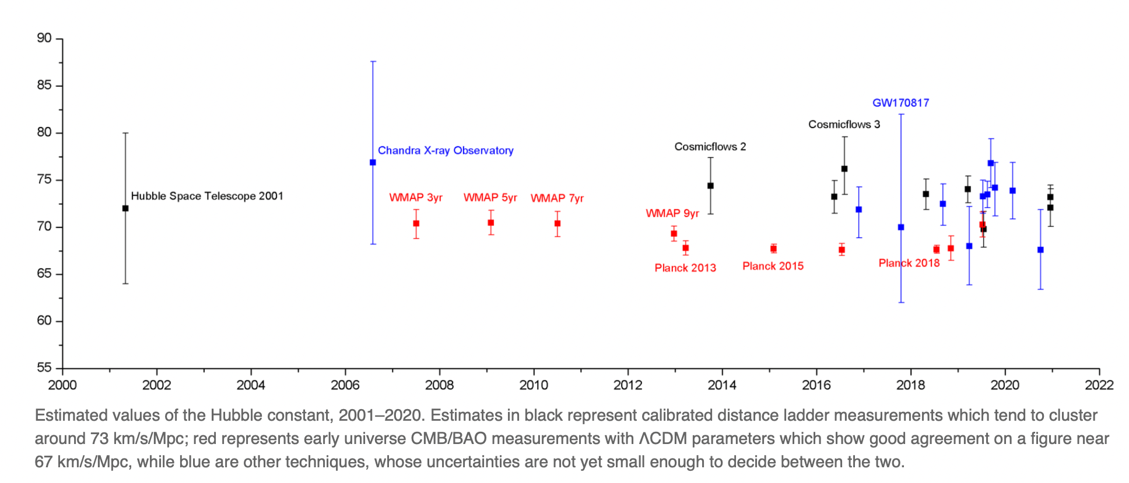
What is Hubble Tension ?
The variation we get during the calculation of Hubble constant by using different techniques and technology is called H₀ Tension.

Slide 3
The range for the values of H₀ lies between 67 Km s⁻¹ Mpc ⁻¹ - 74 Km s⁻¹ Mpc ⁻¹ .
Hubble tension is a matter of Concern as Hubble constant helps us to define the expansion rate of the Universe and hence, the receding velocities of astronomical bodies, age of Universe, etc.
But with successive measurments we are getting better and better precision for the value of H₀ .
Various research groups are working around the globe on it.

Slide 4
“Potential solutions to Hubble Tension”
Early dark energy (EDE) that behaves like a cosmological constant at early times (redshifts z ≳ 3000) and then dilutes away like radiation or faster at later times can solve the Hubble tension. In these models, the sound horizon at decoupling is reduced resulting in a larger value of the Hubble parameter H_{o} inferred from the cosmic microwave background (CMB). We consider two physical models for this EDE, one involving an oscillating scalar field and another a slowly rolling field. We perform a detailed calculation of the evolution of perturbations in these models. A Markov Chain Monte Carlo (MCMC) search of the parameter space for the EDE parameters, in conjunction with the standard cosmological parameters, identifies regions in which H_{o} inferred from Planck CMB data agrees with the SH0ES local measurement. In these cosmologies, current baryon acoustic oscillation and supernova data are described as successfully as in the cold dark matter model with a cosmological constant, while the fit to Planck data is slightly improved. Future CMB and large-scale-structure surveys will further probe this scenario.

Slide 5
ΛCDM (“sm”)
Standard Models
ΛCDM-Nx (“smx”)
Potential Solution
oscillating scalar field
Early Dark Energy
Slowly rolling field

Slide 6
Standard Models ~
1} ΛCDM (Lambda Cold Dark Matter) - H₀^{p} = 67 Km s⁻¹ Mpc ⁻¹
2} ΛCDM-Nx (Lambda Cold Matter - Nx) - H₀^{R} = 74 Km s⁻¹ Mpc ⁻¹
Here, we have assumed in our models (ΛCDM) and (ΛCDM-Nx) the same amount of matter and radiation at the present time but with different value H_{o}.
The primary difference between the two model is the extra dark energy component in (ΛCDM-Nx) model to compensate for the larger value of H_{o}.

Slide 7
ΛCDM (Lambda Cold Dark Matter) ~
“Sm” corresponds to a Universe with CDM , a cosmological constant Λ (lambda) as Dark Energy.

Slide 8
ΛCDM-Nx (Lambda Cold Matter - Nx) ~
The ΛCDM-Nx has an extra parameter for the dark energy component as described -
“sm”
ρ_{sm} = ρ_{r}^{sm} + ρ_{m}^{sm} + ρ_{Λ}^{sm}
“smx”
ρ_{smx} = ρ_{r}^{smx} + ρ_{m}^{smx} + ρ_{Λ}^{smx} + ρ_{ex}^{smx}

Slide 9
EDE (Early Dark Energy) ~
EDE behaves like cosmological constant at early times and then dilutes away like radiation or faster than radiation. In these models, the sound horizon at decoupling is reduced resulting in larger vale of H_{o} .
Two fields are described as ~
1} An Oscillating scalar field.
2} A Slowly rolling field.

Slide 10
An Oscillating scalar field ~
A scalar field (ɸ) with a potential V(ɸ) 𝛂 (1 - Cos[ɸ/f])^{n}
At early times field is frozen and acts as a cosmological constant, but when the hubble parameter drops below a certain value, at a critical redshift of (z_{c} = a_{c}⁻¹ -1), the field becomes to oscillate and then behave as a fluid with an equation of state.
(w_{n} = n-1/ n+1).
In practice, numerical evaluation of the scalar-field equation of motion become rapid compared with expansion rate and so our numerical work is accomplished with an effective fluid approach,that has been tailored specifically for this potential. Still, as that work (and discussion below) indicates, our conclusions do not depend on the details of the potential and would work just as well with, e.g., a simpler φ^{2n} potential.

Slide 11
Slowly Rolling Field ~
It is a fluid that slowly rolls down a potential that is linear in (ɸ) at early times and asymptotes to zero at late times. Numerical evolution of the scalar-field equations of motion confirms that the resolutions we find here with the effective-fluid approach are valid for that model as well.

Slide 12
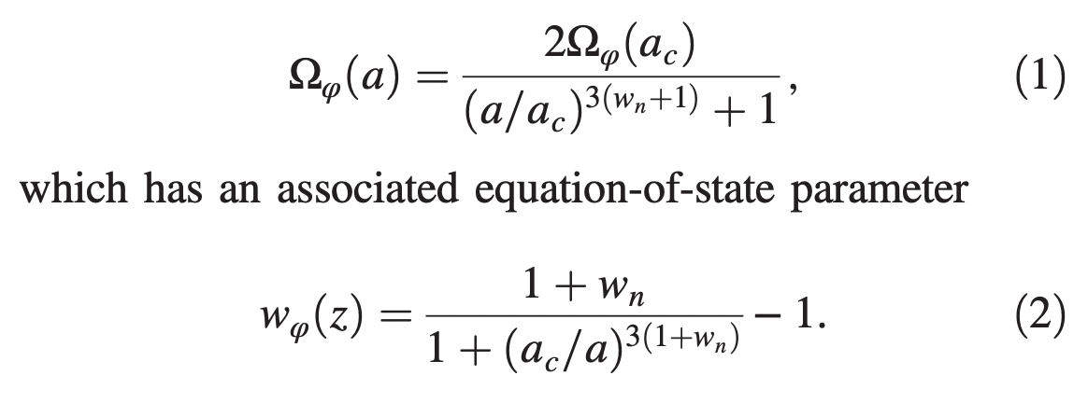
In the effective-fluid approximation, the EDE energy density evolves as ~

Slide 13
It asymptotically approaches −1 as a → 0 and w_{n} for a ≫ a_{c}, showing that the energy density is constant at early times and dilutes as a^{-3(1+w)} once the field is dynamical . The homogeneous EDE energy density dilutes like matter for n = 1, like radiation for n = 2, and faster than radiation whenever n ≥ 3. For n → ∞, on reaching the minimum of the potential, w∞ = 1 (i.e., the scalar field is fully dominated by its kinetic energy) and the energy density dilutes as a⁻⁶ .

